Slide 1
Data Acquisition System
Chul Min Yeum
Assistant Professor
Civil and Environmental Engineering
University of Waterloo, Canada
CIVE 497 – CIVE 700: Smart Structure Technology
Last updated: 2019-12-30
Notes:
Lecture
Task assignment
My research

Slide 2
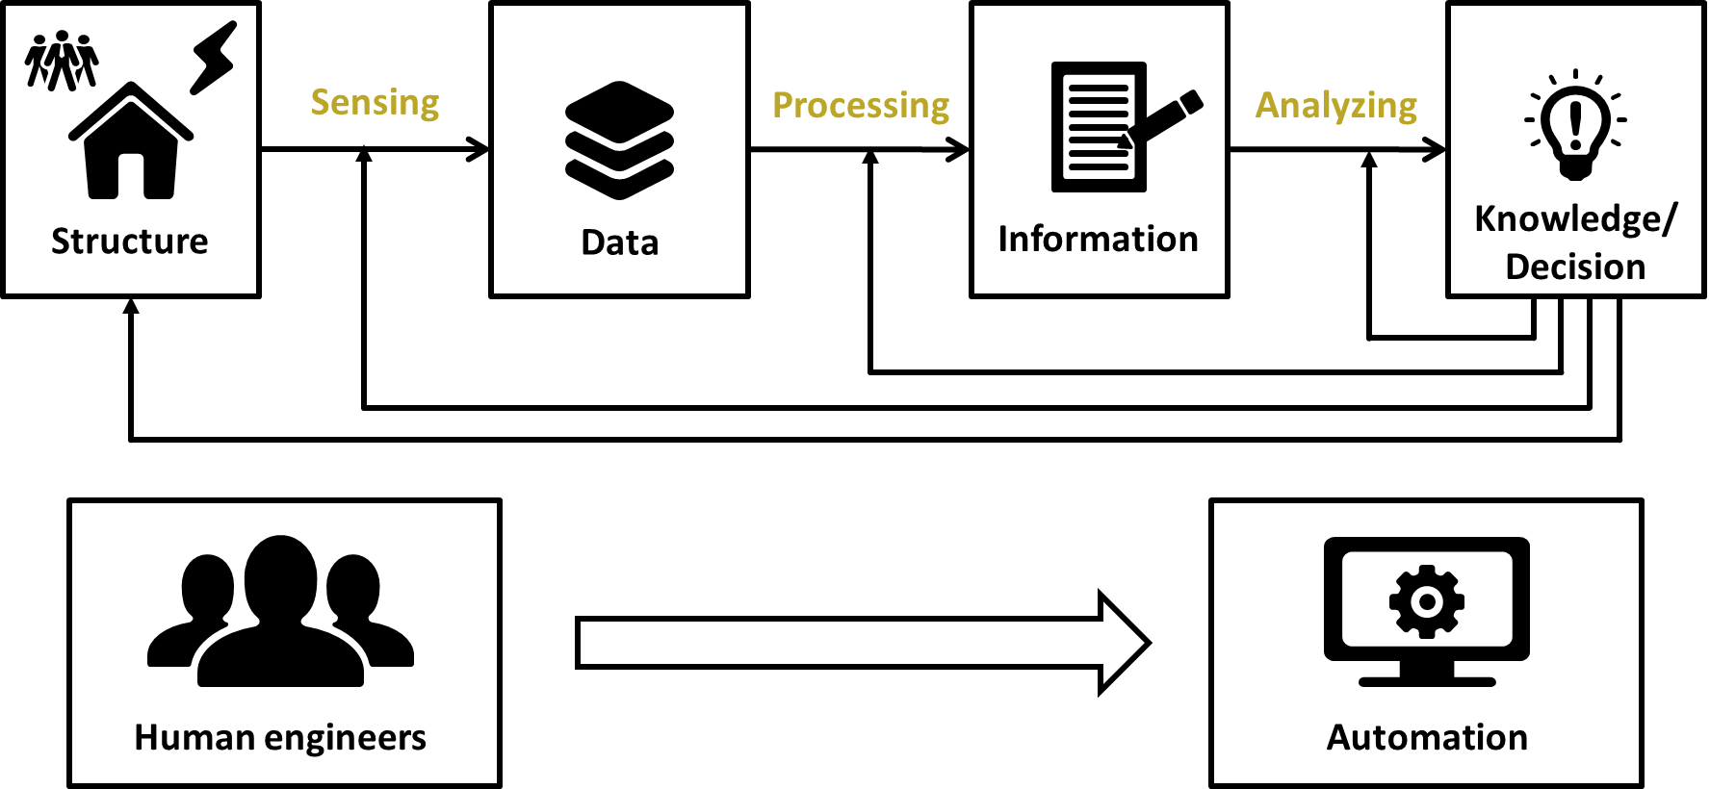
Structural Assessment

Slide 3
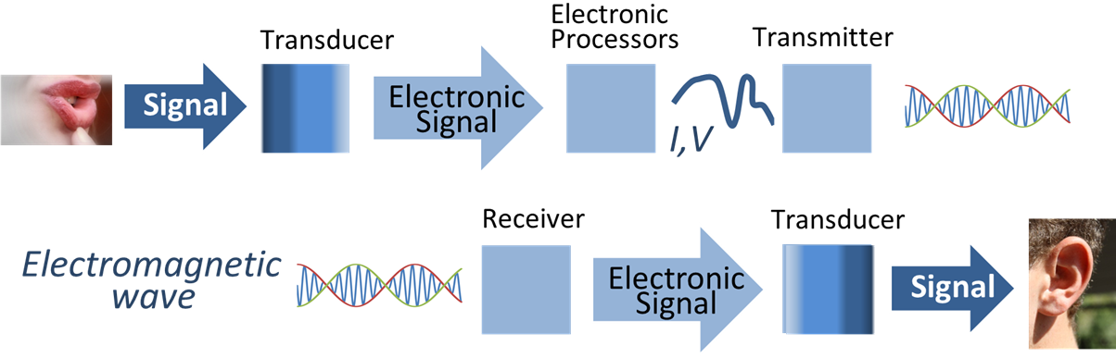
What is Signal Processing?
Signal processing is procedures to reveal the information about the behavior or attributes of some phenomenon contained in the measurements, such as sound, image, or acceleration.
These procedures rely on various transformation that are mathematically based and implemented using digital techniques.
https://en.wikipedia.org/wiki/Signal_processing
Notes:
What is a signal?
temporal or spatial signal
CCTV

Slide 4
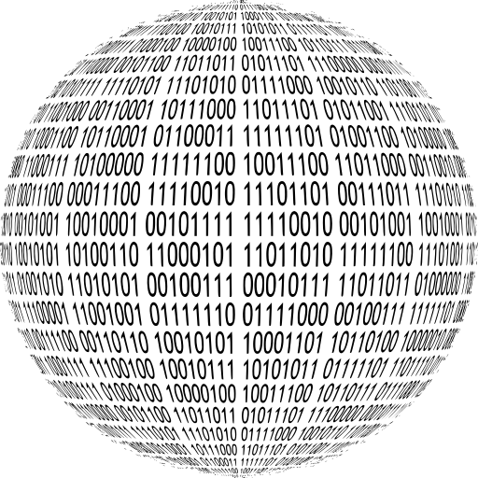
Data Acquisition
Data acquisition is the process of sampling signals that measure real world physical conditions and converting the resulting samples into digital numerical values that can be manipulated by a computer.
Data acquisition systems are used by most engineers and scientists for laboratory research, industrial control, test, and measurement to input and output data to and from a computer.
Welcome to Digital World !!!!
Notes:
https://en.wikipedia.org/wiki/Signal_processing

Slide 5
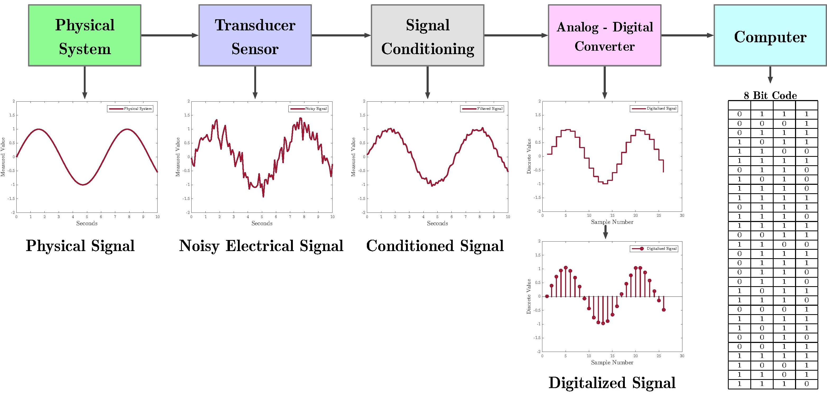
Data Acquisition Diagram
Sensors, to convert physical parameters to electrical signals.
Signal conditioning circuitry, to convert sensor signals into a form that can be converted to digital values.
Analog-to-digital converters, to convert conditioned sensor signals to digital values.
https://en.wikipedia.org/wiki/Data_acquisition
Notes:
Microphone

Slide 6
Analog vs Digital Signal
A digital signal refers to an electrical signal that is converted into a pattern of bits. Unlike an analog signal, which is a continuous signal that contains time-varying quantities, a digital signal has a discrete value at each sampling point. Several issues need to be solved to minimize distortion of the original signal (sampling, quantization, aliasing, and leakage).
Continuous-time vs Discrete-time signal
Continuous-valued vs Discrete-valued signal
Output range
Note that in certain physical situations, 'time' may not be the natural independent variable, for example, a plot of road roughness as a function of spatial position. Similarly, the images are considered as signals (functions) with respect to x and y pixels values.
Notes:
Digitized World

Slide 7



Example: Imaging System
Digital Image Acquisition
Pixel

Slide 8
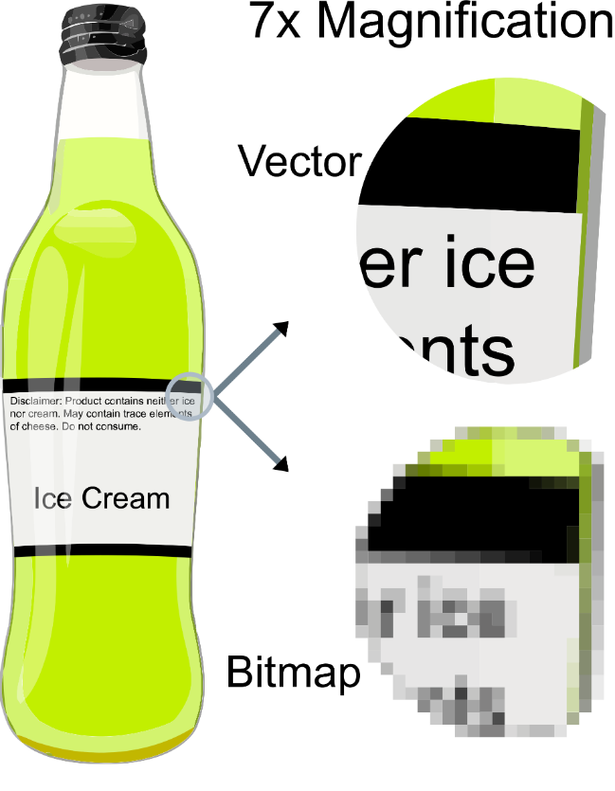

Example: Vector Graphics
Vector graphics is the creation of digital images through a sequence of commands or mathematical statements that place lines and shapes in a given two-dimensional or three-dimensional space. In physics, a vector is a representation of both a quantity and a direction at the same time.
Acrobat PDF

Slide 9
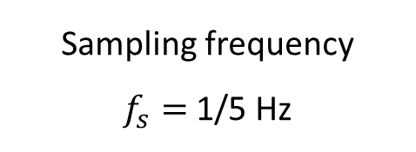

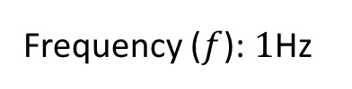
Digitization of Analog Signals
Sampling: How often the data is sampled in the time axis.
$$y=sin⁡(2πft)$$
Frequency ($f$): $1$Hz
Sampling frequency
$f_{s}=$ 1/5 Hz

Slide 10
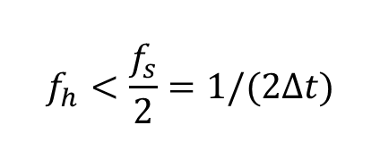
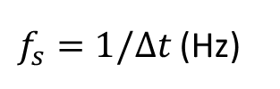

Determination of a Sampling Frequency (Rate)
Sampling frequency (Hz) is the inverse of the sampling interval
$f_{s}=1/∆t$ (Hz)
Make sure the sampling frequency is at least twice the desired frequency to be measured. (When the signal is analyzed in the frequency domain)
$$f_{h}<\frac{f_{s}}{2}=1/(2∆t)$$
10 samples or more digital points during the signal period of interest (when the signal is analyzed in the time domain.
$$∆t$$

Slide 11
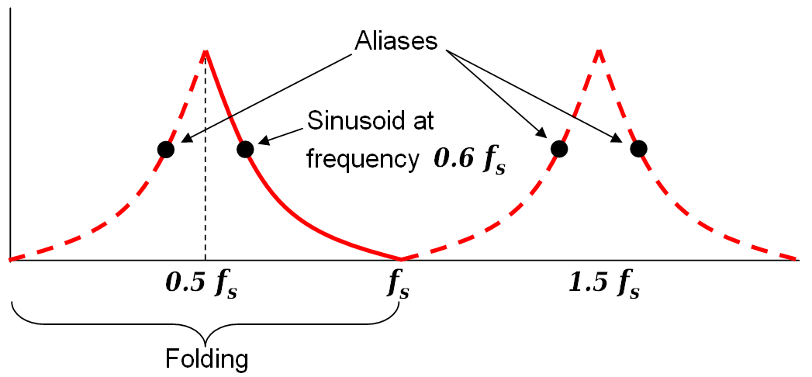
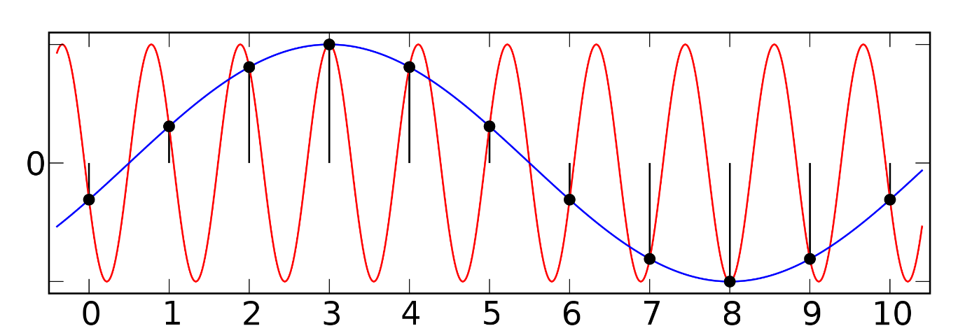
Aliasing
Aliasing refers to the distortion or artifact that results when the signal reconstructed from samples is different from the original continuous signal.
A higher frequency component is disguised as a lower frequency component because of inadequate sampling.
Original signal
Sampled points
Wrap-around
Sample from a sine wave
This aliasing occurs along the half of the sampling frequency.

Slide 12
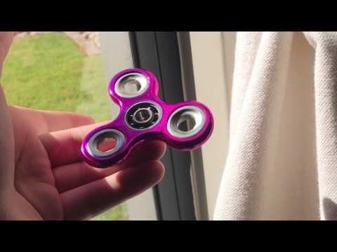
Example: Spinner
https://www.youtube.com/watch?v=cMZJZGtWFCA
Notes:
Draw graph!

Slide 13

Example: Helicopter Like Spaceship
https://www.youtube.com/watch?v=yr3ngmRuGUc

Slide 14
Example: Effect of Aliasing
True signal frequency
Sampling frequency
Nyquist frequency
Sampling frequency
Estimated
frequency
Nyquist frequency

Slide 15
Example: Spatial Aliasing
Original image (1200 x 1200)
Resampling (50 X 50)
Resampling (15 X 15)

Slide 16

Example: Spatial Aliasing (Continue)
1:40 – 1:50
Notes:
Matlab tutorial

Slide 17
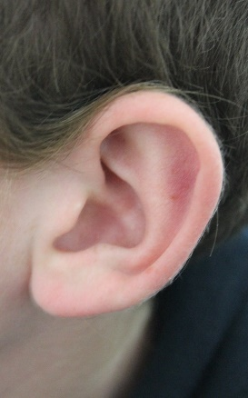






Anti-Aliasing Analog Filter
FFT of Analog Signal
FFT of Analog Filter
Amplitude
Roll-off
Cut-off frequency
$$f_{s}$$
$$f_{s}$$
$$f_{s}/2$$
$$f_{s}/2$$
FFT of Filtered Signal
Frequency (Hz)
Frequency (Hz)
Anti-Aliasing is done before sampling.
$$f_{s}$$
$$f_{s}/2$$
Frequency (Hz)
Notes:
Microphone, your phone?

Slide 18
Oversampling
Oversampling will provide a true picture of the time course of the event being studied but too much oversampling will result in very large data files.
Example: Drawing a graph
Do we really need 200Hz?

Slide 19

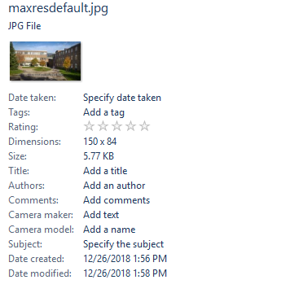
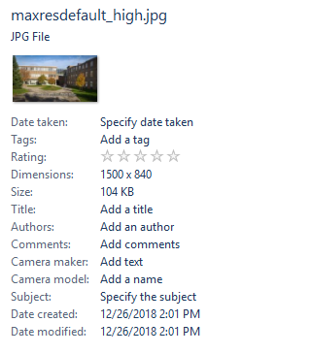

Example: Image Oversampling

Slide 20
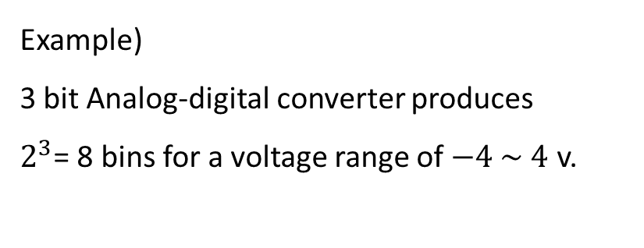
Quantization of Analog Signals
Quantization is the process of constraining an input from a continuous or otherwise large set of values (such as the real numbers) to a discrete set (such as the integers).
An analog signal from a sensor is sampled in time (sampling frequency) and in amplitude (Quantization).
Example)
3 bit Analog-digital converter produces
$2^{3}$= 8 bins for a voltage range of $−4 \sim 4$ v.
Quantization error

Slide 21
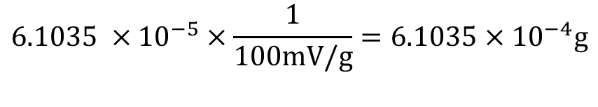
Example for Resolution Calculation
Given parameters
Sensor sensitivity: 100mV/g
Voltage output range: -2V to +2V
# of ADC bits: 16 bits
Calculation
16 bit ADC divides the full scale voltage into 2¹⁶ = 65536 bins
Resolution in terms of voltage: 4V/65536 = 6.1035e-005V
Resolution in terms of acceleration:
$$6.1035 ×{10}^{−5}×\frac{1}{100mV/g}=6.1035×{10}^{−4}g$$
$Resolution \left(g\right)=$ $\frac{Output voltage range (V)}{2^{\# of ADC bits}}×\frac{1}{Sensor Sensitivitiy (V/g) }$

Slide 22
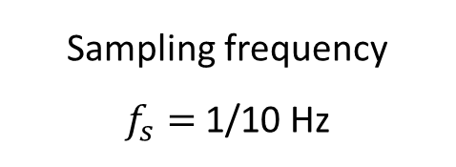
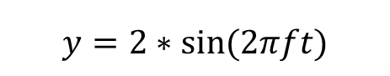
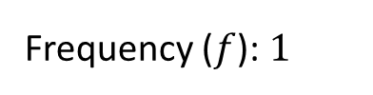
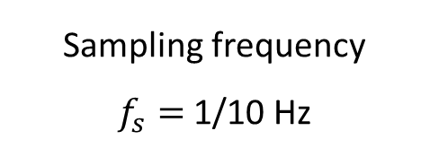
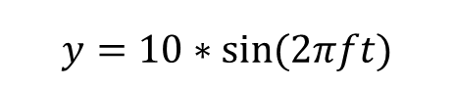
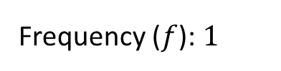
Other Considerations for Resolution
$$y=10∗sin⁡(2πft)$$
Frequency ($f$): $1$
Sampling frequency
$f_{s}=$ 1/10 Hz
3bit ADC
$$y=2∗sin⁡(2πft)$$
Frequency ($f$): $1$
Sampling frequency
$f_{s}=$ 1/10 Hz

Slide 23
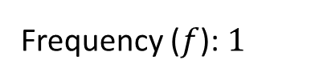
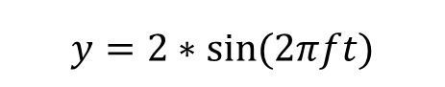
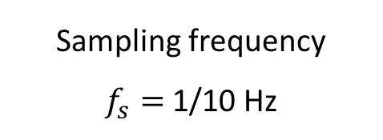
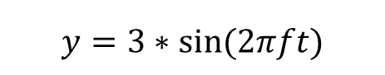
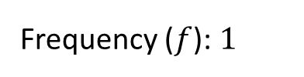
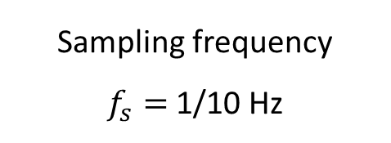
Clipping
$$y=2∗sin⁡(2πft)$$
Frequency ($f$): $1$
Sampling frequency
$f_{s}=$ 1/10 Hz
-2V - 2V
$$y=3∗sin⁡(2πft)$$
Frequency ($f$): $1$
Sampling frequency
$f_{s}=$ 1/10 Hz

Slide 24
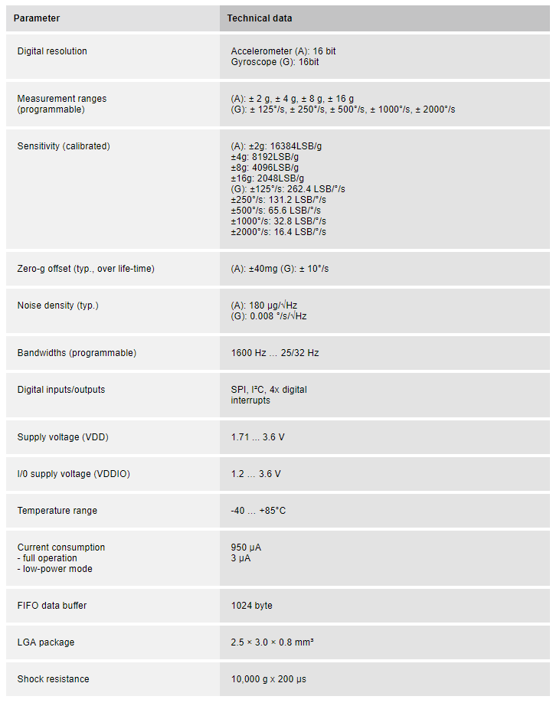
Example: Accelerometer in IPhone X Accelerometer
BMI 160, Bosch Sensortec
LSB: Least Square Bit
2¹⁶ = 65536 bins
https://www.bosch-sensortec.com/bst/products/all_products/bmi160
Notes:
https://www.bosch-sensortec.com/bst/products/all_products/bmi160
https://www.edaboard.com/showthread.php?250221-Accelerometer-Questions
http://www2.hawaii.edu/~peterb/resources/equipment/analog_devices_accelermoter_specifications.pdf

Slide 25
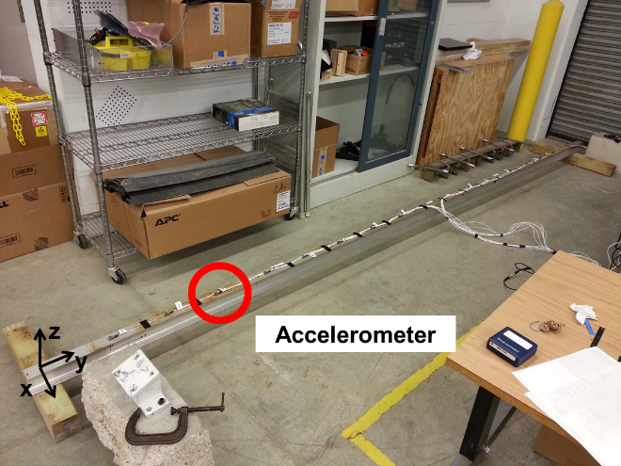
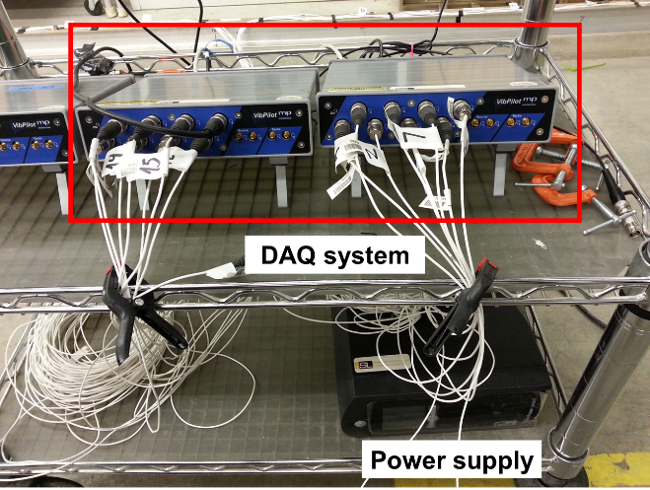
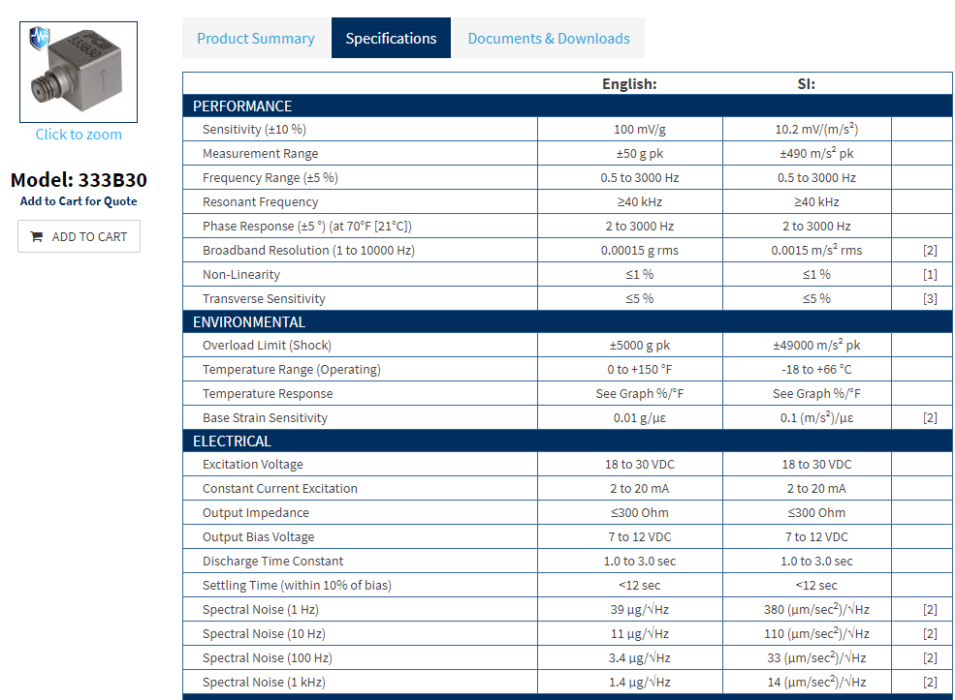
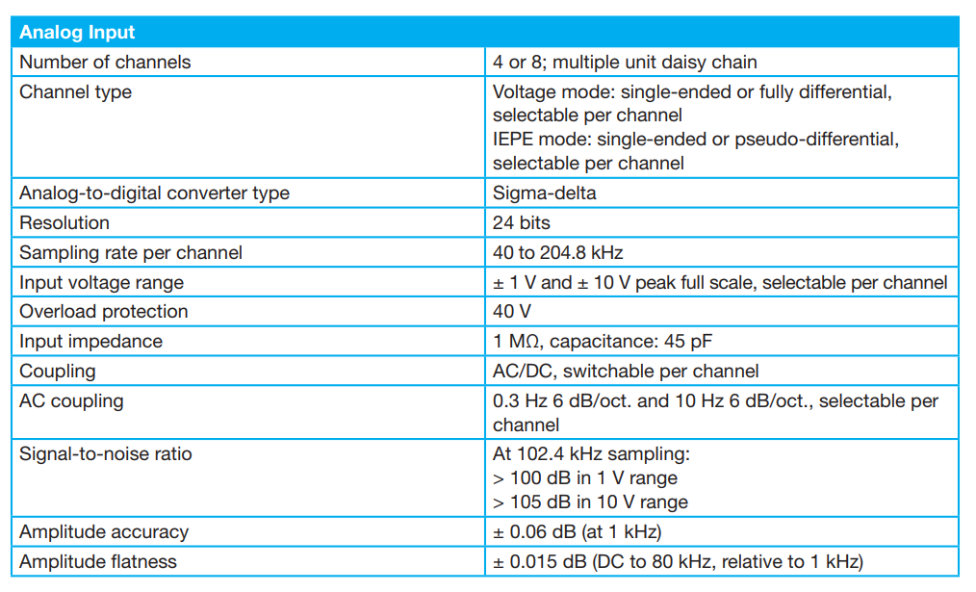
Example: Modal Testing
↑ Accelerometer
← Data acquisition system

Slide 26
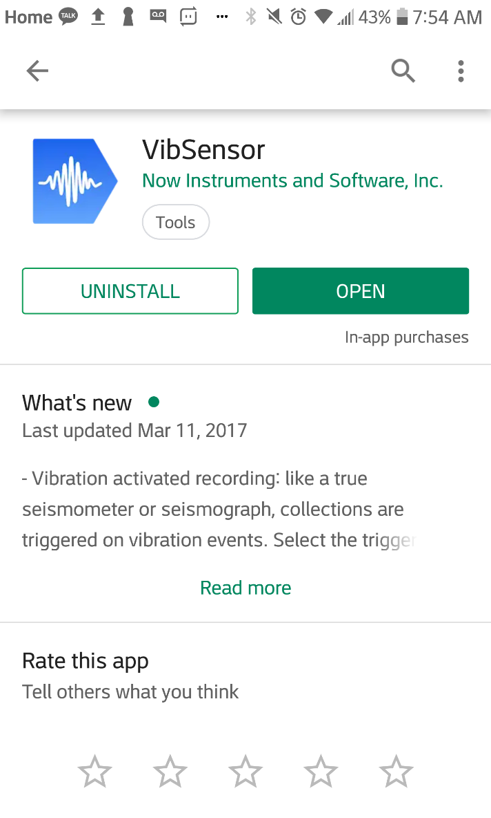
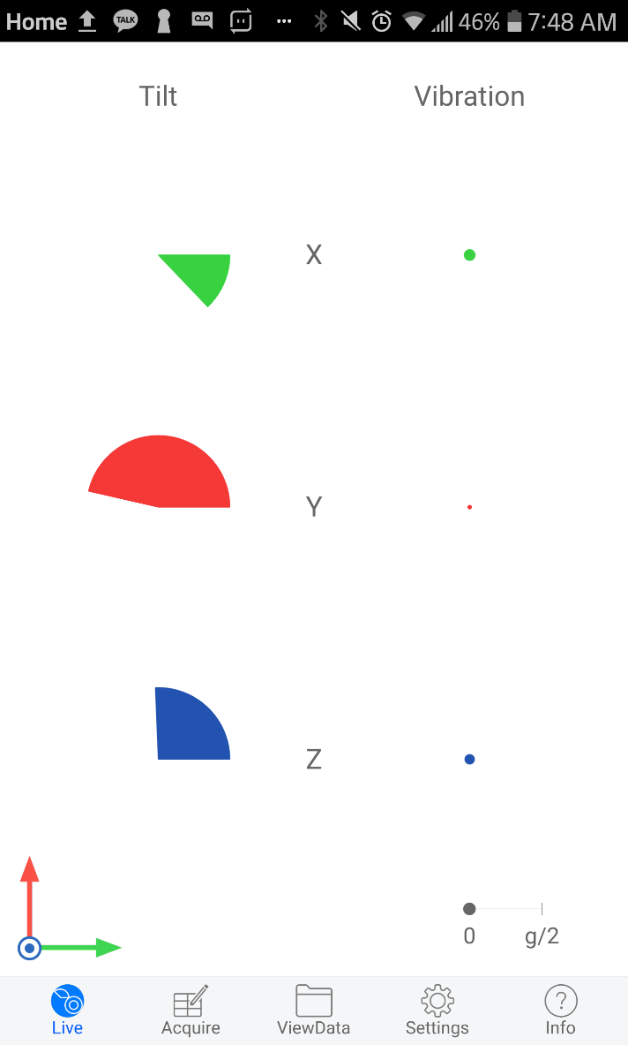
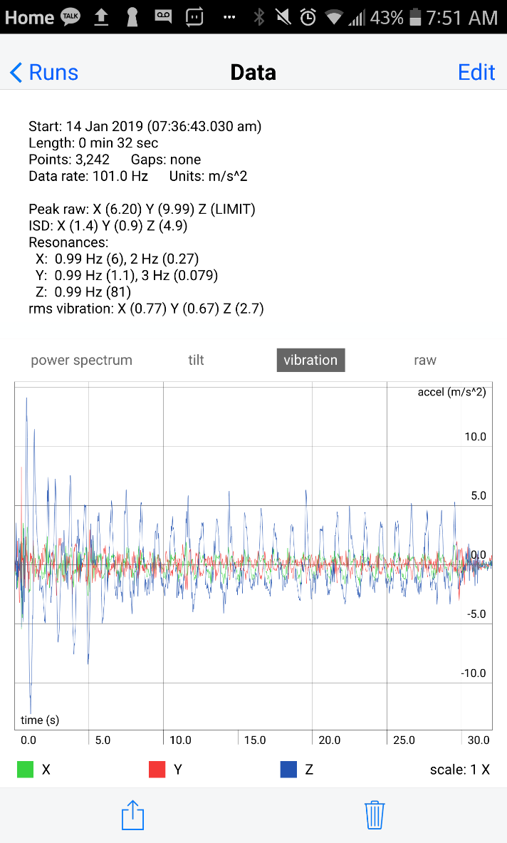
Demo: Acceleration Measurement using a Smart Phone – VibSensor
http://www.now-instruments.com/get-help/5-vibsensor-user-guide

Slide 27
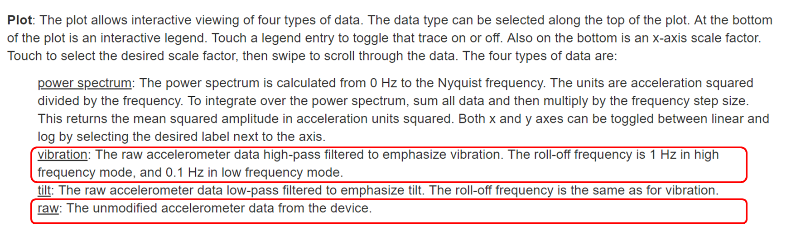
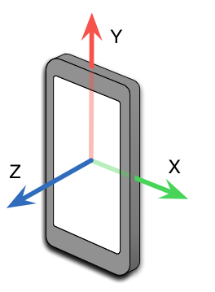
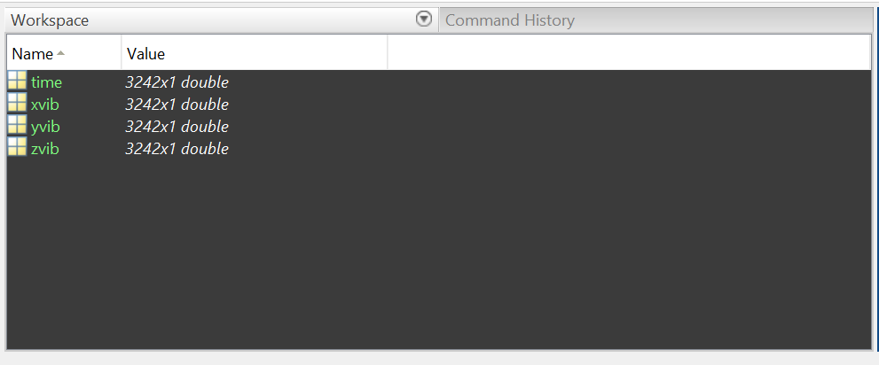
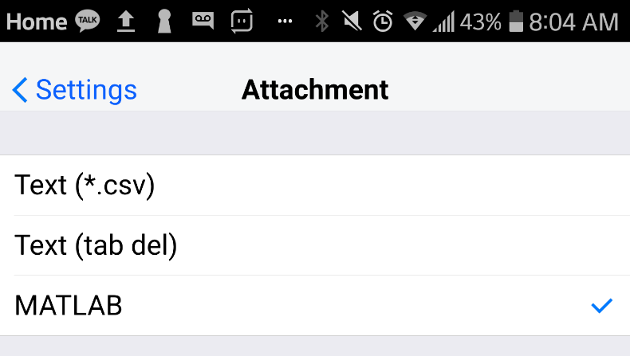
Demo: Acceleration Measurement using a Smart Phone – Vibration Measurement
https://www.google.com/search?q=metronome

Slide 28
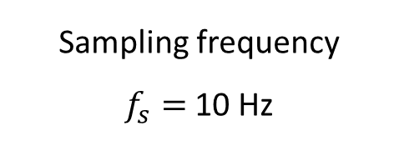
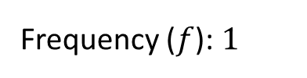
Demo: Acceleration Measurement using a Smart Phone – Vibration Analysis
Frequency ($f$): $1$
Sampling frequency
$f_{s}=$ 10 Hz

Slide 29
Demo: Acceleration Measurement using a Smart Phone – Clipping

Slide 30
Slide Credits and References
Shin, K., & Hammond, J. K. (2008). Fundamentals of Signal Processing: for Sound and Vibration Engineers, 418.
http://www.now-instruments.com/get-help/5-vibsensor-user-guide
http://courses.me.metu.edu.tr/courses/me410/notes/Week10/Week10.pdf
Introduction to Smart Structure Technology (Spring 2009, KAIST)
https://www.bosch-sensortec.com/bst/products/all_products/bmi160
https://www.edaboard.com/showthread.php?250221-Accelerometer-Questions
http://www2.hawaii.edu/~peterb/resources/equipment/analog_devices_accelermoter_specifications.pdf
https://www.mpihome.com/files/mppdf/mppdf_product_guide/mp_ProductGuide_VibPilot.pdf
http://www.lb-acoustics.at/wp-content/uploads/2018/05/data_mp_vibpilot_en.pdf
http://www.pcb.com/products/model/333b30

